Slide 1

2nd Annual General Meeting (AGM)
29 August, 2026

Slide 2

Agenda
Quick recap of previous joint meeting held on 31 May, 2026
Welcome New Member
Open Discussion on - The Future of DGH
Ideas for Fund Raising Campaign
Update on our Banking status/books
Q&A and Closing
90 minutes

Slide 3
Recap of Previous Joint Meeting
31 May, 2026
The Journey of SPDGH
Motivation Behind Forming the Society
Mission Statement
Goals and Objectives
Accomplishments to Date
Organizational Structure
Member Benefits
Q&A
Website: http://dghpreservation.com/
Email: talktous@spdgh.com
Follow us on Facebook: Society for the Preservation of Dr. Grahams' Homes

Slide 4

Welcome New Member
(General Body)
Fiona Demorais
Society Structure:
General Body (8 to 10 members)
Executive Committee/Managing Body (8 to 10 members)
Board of Trustees (4 to 5 members)
General Members (Unlimited)
Notes:
Eligible:
Voting for members to join SPDGH
Eligile to take up office as President or any other position (Secretary, Treasurer, etc...) based on voting by GB Members and EC Members

Slide 5
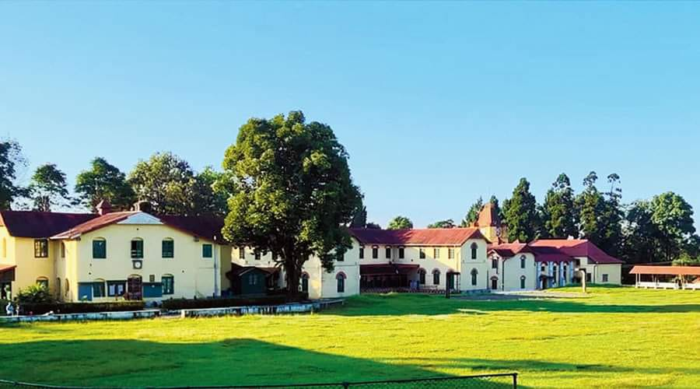


Open Discussion
The Future of DGH
What can we do to support our Alma Mater?
Notes:
To put this into perspective and open the discussion…….Lets view a few Pros and Cons

Slide 6
Open Discussion
Pros
Cons
Land Holding@270.5 acres (pending confirmation)
Financial standing improved (overall accumulated deficit has decreased by approx. 50% - pending confirmation)
Performance Appraisals introduced for Cottage parents
Fixtures and Fittings for security and safety - Donations from OGBs and well-wishers
  CCTV cameras installation
  Electrical and wiring works underway
  Call for BOM Nominations - Hope to recruit good candidates
Dwindling number of Boarders and Sponsored children
Dilapitated buildings
Decline of a free offer from SPDGH, to renovate the SMH
Continued lack of Transparency by the BOM
Introduction of NDA (Non-Disclosure Agreement) for members joining the BOM
Refusal for any Open discussion with the larger OGB Community. Closed/controlled Town Halls.
Stereo-type approach towards project permissions and approvals
Notes:
Land Holding@270.5 acres (pending confirmation) - Government approved.
Each area is categories into plots:
For example:
Church Plot 1: 2 acres
JH Plot 2: 3 acres
Ahava Plot 3: 1 acres
So, we need to find out Plot number for SMH and then check if its within the list of the 270.5 acres
Financial standing improved (overall accumulated deficit has decreased by approx. 50% - pending confirmation) - For example: 12 Cr now 6 Cr
Performance Appraisals introduced for Cottage parents. However, it needs to be executed alittle more better. Currently, its just one persons prespective and then graded by Pauline....So, it can be open to abuse and favioritism.
Fixtures and Fittings for security and safety - Donations from OGBs and well-wishers
CCTV cameras installation
Electrical and wiring works underway
Call for BOM Nominations - Hope to recruit good candidates: Encourage more from SPDGH to apply. Theres currently a Max of 6 Open postions.
John asked the question about the - Transfer of Sponsorship Management from under DGHUK to DGH-BOM directly. Is this a Pro or Con (debatable)?

Slide 7
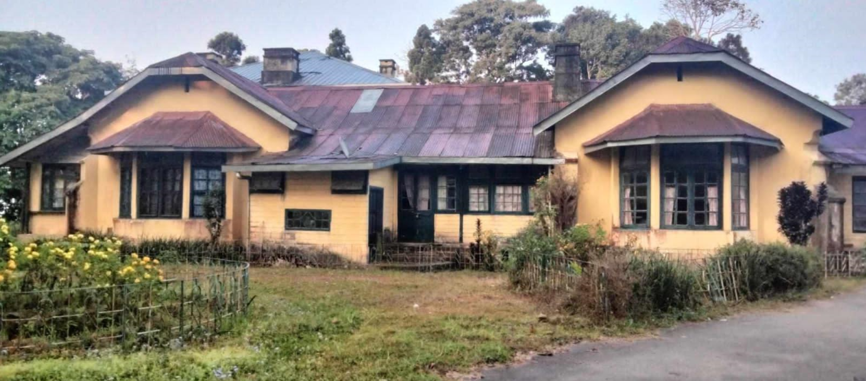
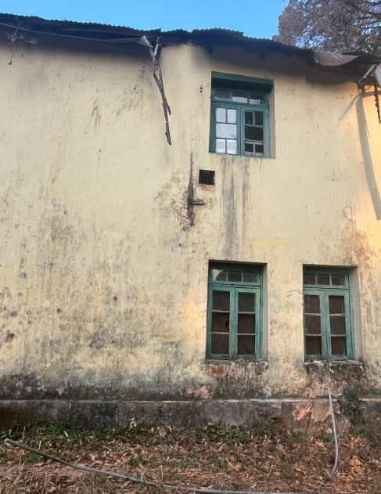
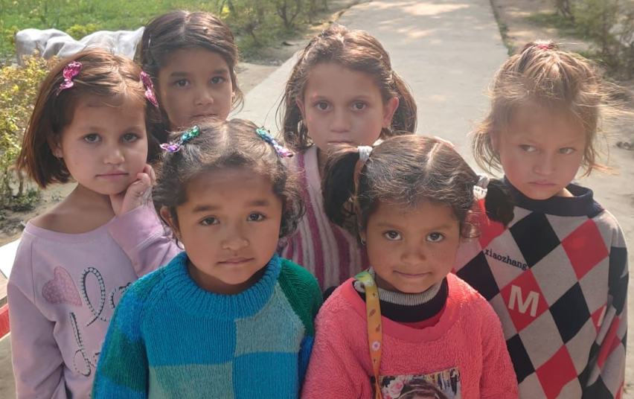
Fund Raising Campaign
Notes:
Ideas for Fund Raising Campaigns
Steps we have taken to encourage collaboration amongst OGB groups & the BOM
Proposal to do up all the closed cottages - BOMs Response:
Not a registered organization,
Choose one building – Chose Holiday Home (no written approval)
Chose Willingdon (no written approval);
Sent proposal to renovate SMH – Not an in fractural priority
Called for an Open discussion during the 125th B’day Celebration – Declined by Chair
Call for Nominations to the BOM and active participation towards SPDGH (book keeping, fbk interactivity, getting more supporters)

Slide 8
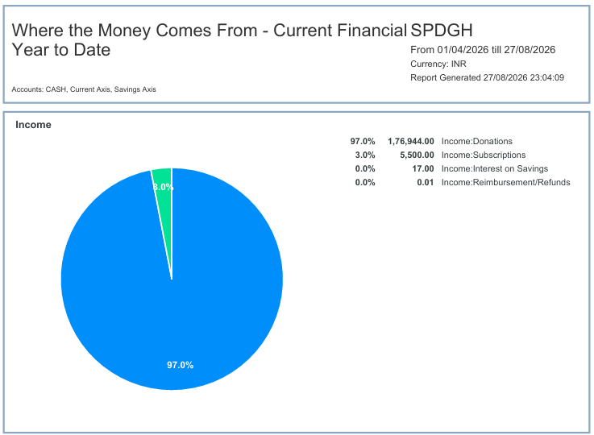
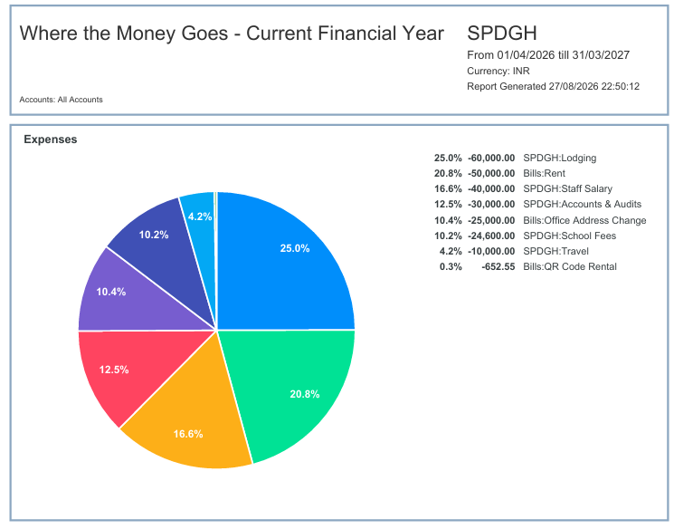
Banking Update YTD
Overall
(Inc. C/F from 2025)
C/B from 2025: 1,60,253.89/-
Income in 2026: 1,82,461.01/-
Expenses in 2026: 2,40,252.55/-
Current balance 2026: 1,02,462.35/-
Reserves at two external sources:
    Source 1: 5,50,000/-
    Source 2: XXXXX/-
Total: 182,461.01/-
Total: -240,252.55/-
Notes:
C/B from 2025: 1,60,253.89/-
Income in 2026: 1,82,461.01/-
Brought the Bal to: 3,42,714.90/-

Slide 9

Q&A and Close
What additional questions do you have for us?

Slide 10
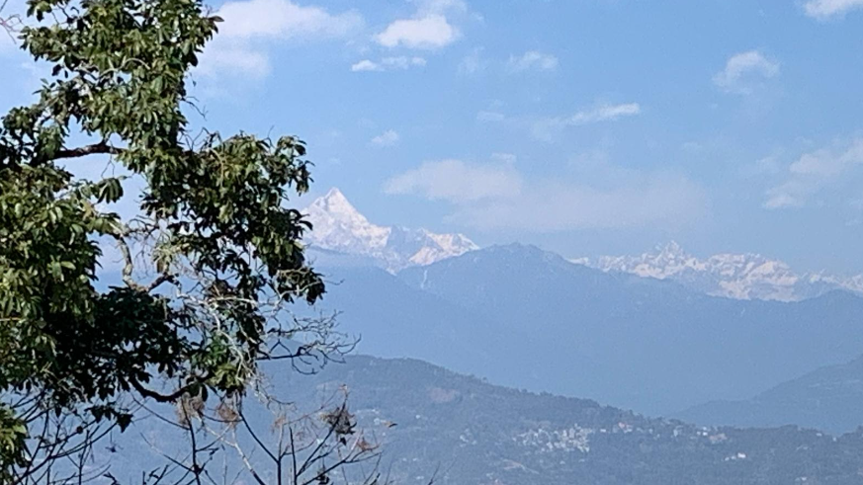
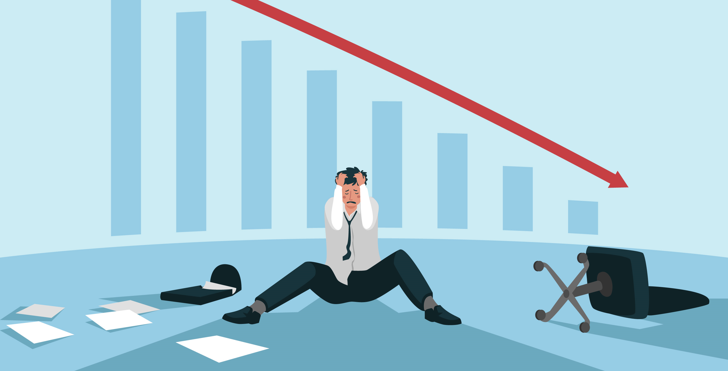
Call for Good Leadership (at the Board and School levels)
Thank you for joining
Stay in touch ☺
Website: http://dghpreservation.com/
Email: talktous@spdgh.com
Follow us on Facebook: Society for the Preservation of Dr. Grahams' Homes

